Slide 1
Public Health
Nuisance Complaints
Courtney Myers, MPH, REHS
Unit Manager
Notes:
Hello- My name is Courtney, and I have been at the Stark County Health Department for 19 years. Working in many EH programs. Most of the past 10 plus years in creating the sewage Operations and Maintenance Program., Pools, Beaches. This past summer I stepped into the unit manager role vacated by Randy Ruszkowski. Happy to be hear today.

Slide 2
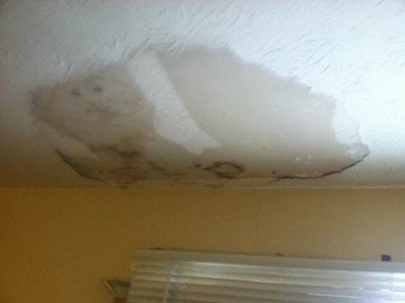
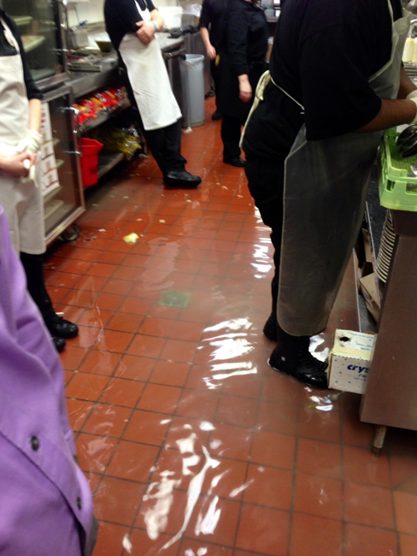
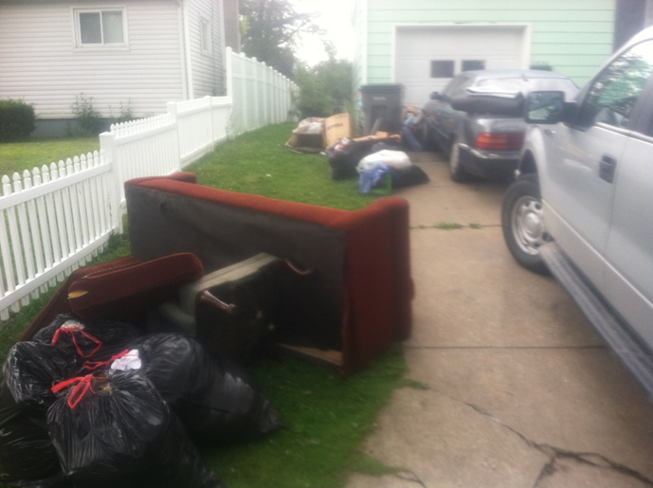
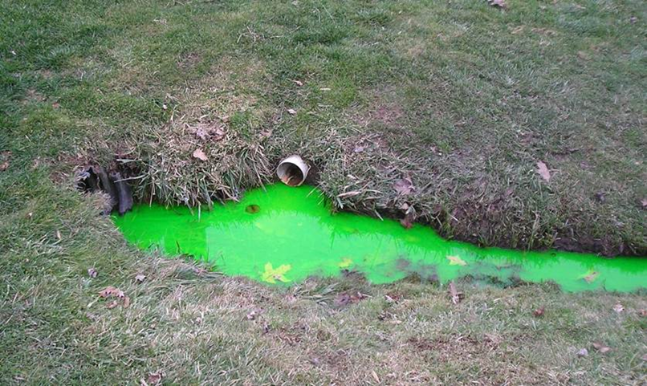
All Complaints Are Different
Notes:
The goal of our nuisance program is to hold property owners or operators accountable for resolving public health nuisances on their property or facility.
Authority in each case may vary. But in all cases, our goal is to utilize the power granted by the legislature to protect public health. So theses case of mold, restaurant with sewage backup in commercial kitchens, solid waste without garbage pickup, and green dye indicate a failed septic system.

Slide 3
Agenda
Public Health Nuisance (PHN)
PHN Complaint Types
“Eye Sores” – No Authority
Complaint Process
Dangerous Structures
Notes:
Today we are going to touch on the following topics: define PHN, go through our complaint types that our agency has authority over, review those eye sores that we cannot pursue, Our comlaint process, Final the protocol if your political subdivision would like a structure deemed as dangerous structures because you intend on demolishing the structure.

Slide 4
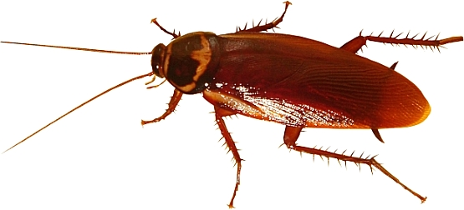
WHAT CONSTITUTES A
PUBLIC HEALTH NUISANCE?
Must have a public health significance
  Prevent the spread of disease
  OR
Be written specifically in the Ohio Code.
  Open dumping of Solid Waste, C&DD, Scrap tires…
  Food Safety Code
  Sewage Regulations
Notes:
Let’s define a Public Health Nuisance. It must have a public health significance. Our objective is the spread of disease. Or specifically written in the Ohio code. So those are the only criteria we utilize to determine if we have authority in pursuing these claims. An untidy property may not fall under our authority.

Slide 5
Public Health Nuisance
Any condition that is likely to cause the spread of disease or is defined by the Ohio codes.
Mold (within rental property only)
Raw Sewage Spills & Sewage System Malfunctions
Open Dumping of Solid Waste and/or Construction and Demolition Debris
Mosquito Breeding Areas
Unvaccinated Pets
Disease-Carrying Vectors
Improper Handling of Scrap Tires
Smoke Free Ohio
Licensed Facilities (Food, Pools, Beaches, Body Art)
Notes:
These are the situations in which, if we begin our nuisance protocol, we can win when we stand in front of a judge. We do not want infringe on rights

Slide 6
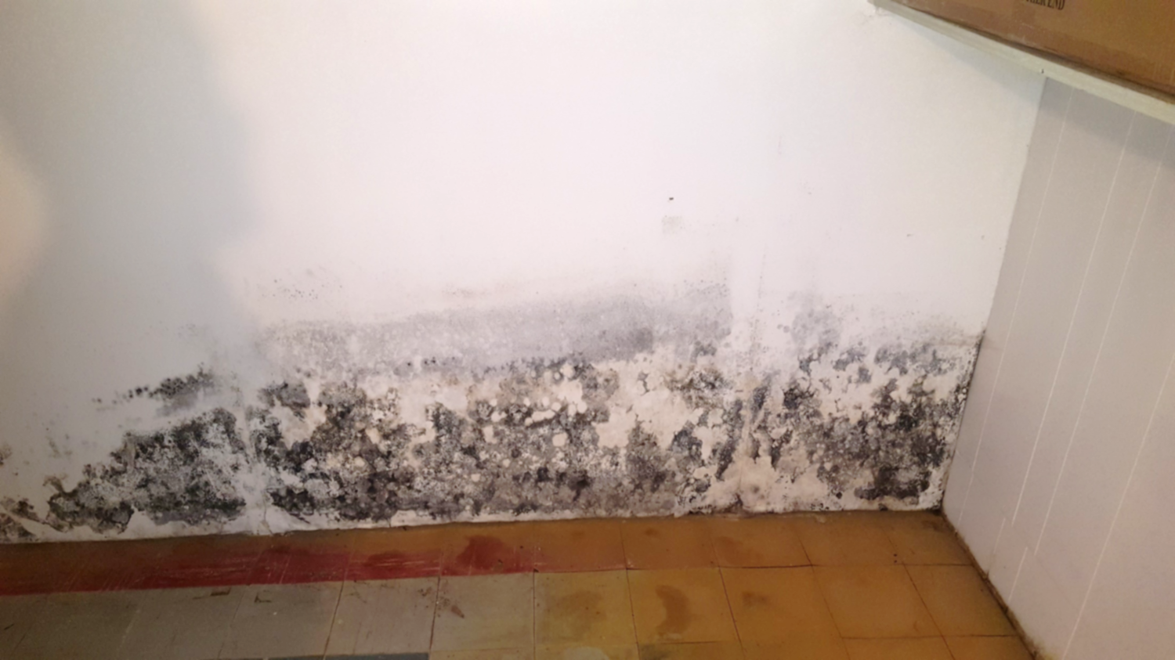
MOLD (IN RENTAL PROPERTIES)
PUBLIC HEALTH NUISANCE
Notes:
The Ohio Department of Health has a limited role. Most departments do not do mold cases. Our office works within rental situations. Ohio Revised Code 5302.30 requires a property disclosure form for all residential real estate transactions.
EPA recommends a 10 square foot area can be easily tackled by an owner. Above that, they recommend a professional in mold remediation. Small areas remove the source of water. Wear PPE, a N95 mask. Clean surfaces with Dawn soap, dry completely use a Kilz Primer. Larger areas may have to remove dry wall.
Not all mold is harmful, but we assume it is. Only in rental situations. Once the tenant moves, we issue a letter stating that the mold has been remediated prior to a new tenant.

Slide 7
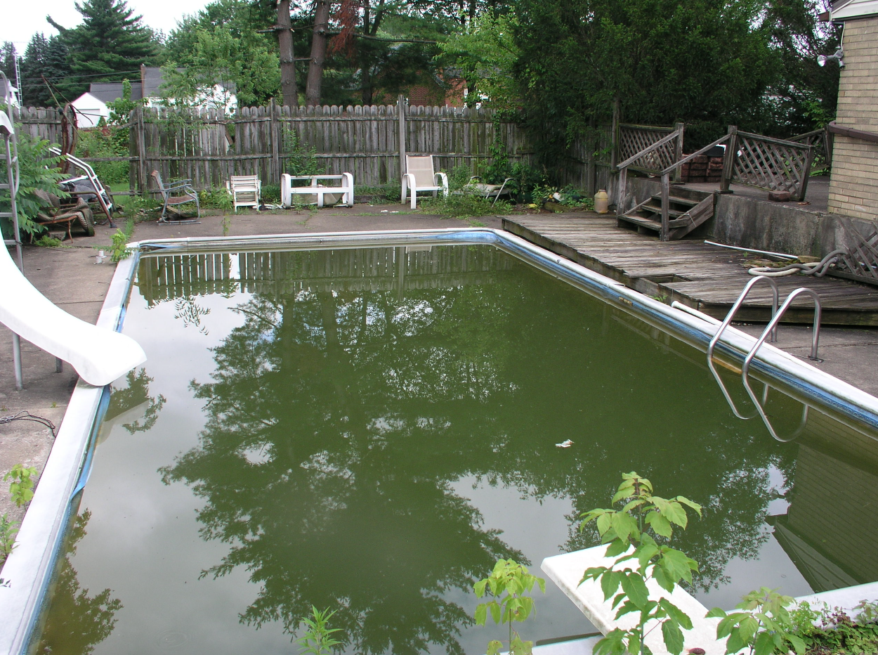
MOSQUITO BREEDING AREAS
PUBLIC HEALTH NUISANCE
Stagnant water from an unmaintained pool.
Notes:
This is an older pic from Broadway ave. Louisville area
Stark Health operates a Mosquito control program. 3 components trapping with disease surveillance, larvicide breeding sites and adulticide mosquitoes. Most people would assume the bulk of our work would be nighttime trucks spraying aduliticide. The larvicide component is the larger task. West Nile virus lacross encephalitis.
Unmaintained breeding locations are treated by our staff if permission is granted by the property owner. If contact cannot be made or a refusal to treatment, then we begin our nuisance legal proceedings.
15,584 mosquitoes collected and grouped into 397 test pools
50 WNV-positive mosquito pools detected in Stark County
2 human cases of West Nile virus in Stark County
1 human case of La Crosse encephalitis in Stark County
552 total spray miles completed using 103.48 gallons of Duet
363 larvicide inspections, with 222 sites treated (with property owners’ permission) or legal measures are taking place
595 pounds of FourStar CRG and 22.5 pounds of Skeeter Abate applied

Slide 8
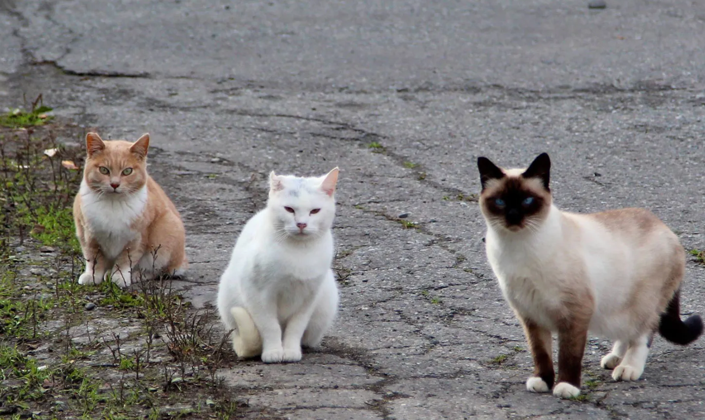
Rabies - Unvaccinated Pets
PUBLIC HEALTH NUISANCE
Notes:
We are not the dog warden. Stray Cats and dogs that we cannot do anything about. But If a person is feeding, then they are responsible for the rabies vaccination. So often people will start feeding all of the neighborhood cats. You feed then you are caring for the animals.

Slide 9
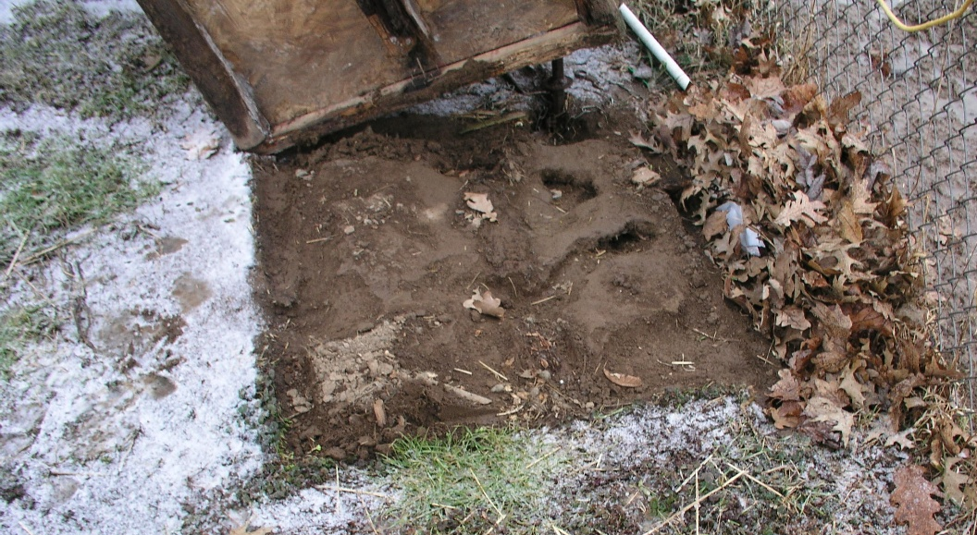
Disease Carrying Vectors
PUBLIC HEALTH NUISANCE
Rodent Burrows
Notes:
So there are a few disease-carrying vectors that we will discuss. The first being rats and rodents. They can pass to humans the hantavirus, leptospirosis, salmonellosis, rat-bite fever, plague, and tularemia. If you remember last year, it was reported that the Actor Gene Hackman and his wife may have died from hantavirus. Later determined that his wife did and he did of heart related issues. Waynesburg is under a doghouse. Rat burrows and tunnels noted. Rectify by removal food source, securing structures.

Slide 10
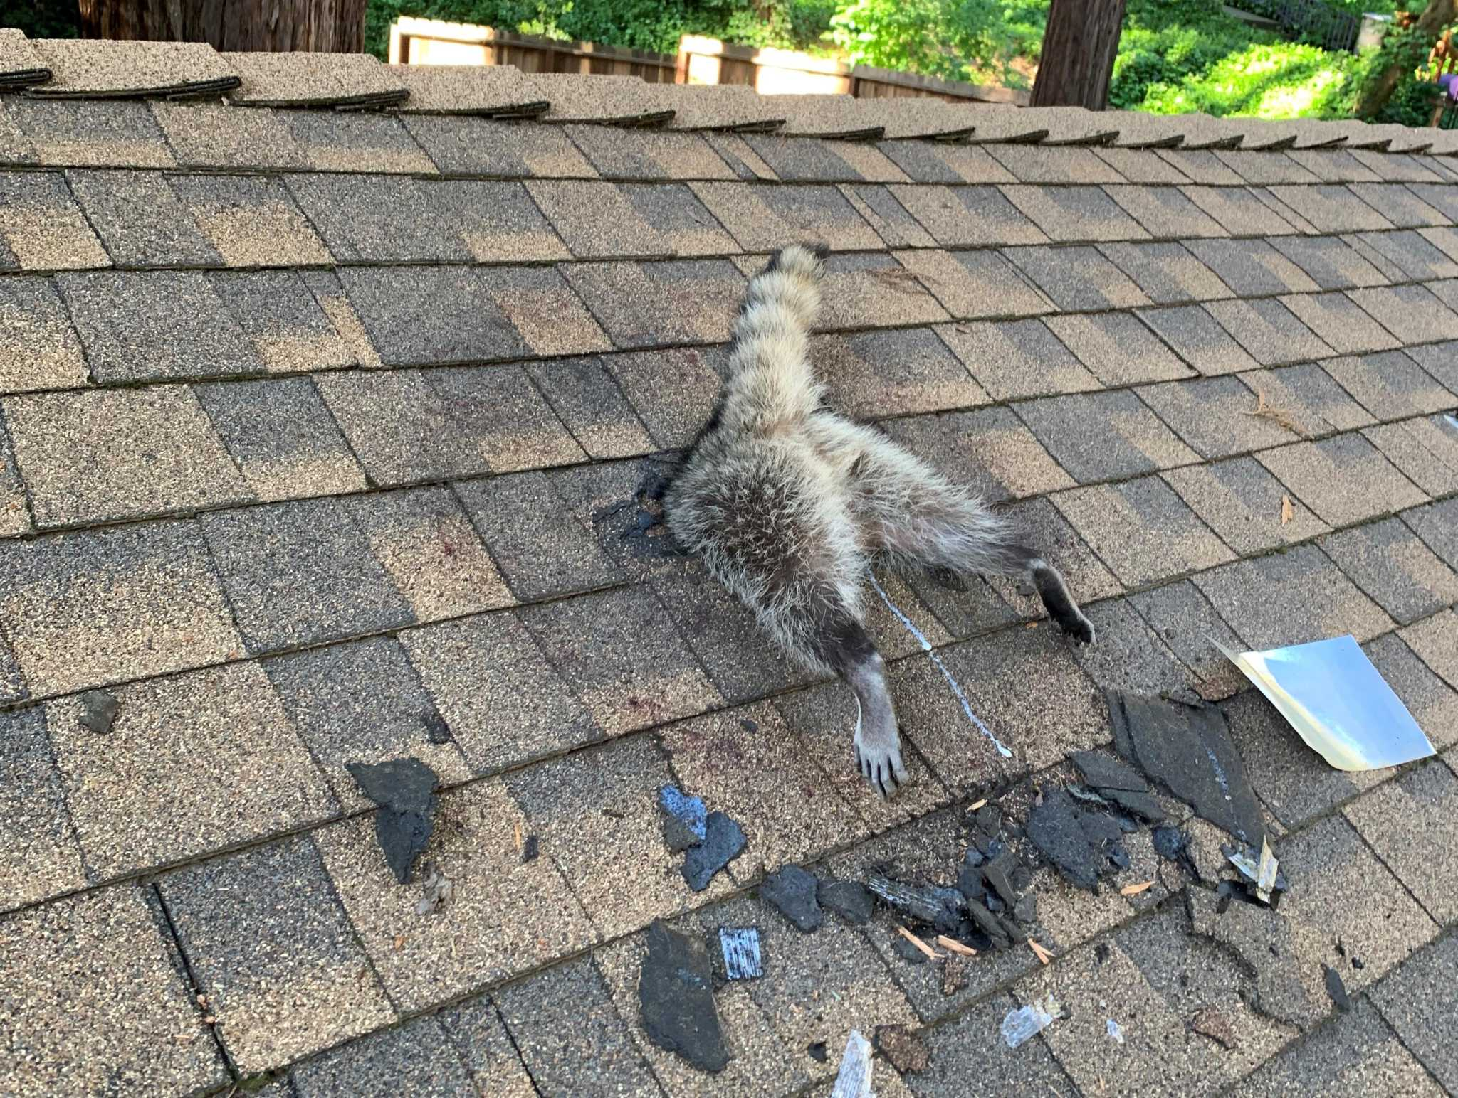
Disease Carrying Vectors
PUBLIC HEALTH NUISANCE
Raccoon Entering Home
Notes:
Now this is a silly image from Google. But we do have several grainy images of raccoons poking their heads out of openings in roofs.
Rabies: Raccoons are a major carrier of the rabies virus in the U.S. It is transmitted through saliva via bites or scratches and is fatal if not treated with post-exposure shots shortly after infection.
Raccoon Roundworm (Baylisascaris procyonis): A parasite found in raccoon feces, roundworm eggs can survive in the environment for years. If ingested (often by children), the larvae can migrate to the brain, eyes, or organs, causing severe, sometimes fatal, neurological damage (neural larva migrans) or blindness (ocular larva migrans).
Leptospirosis: A bacterial infection spread through the urine of infected raccoons. It can cause fever, headaches, jaundice, and kidney or liver failure in humans.
Giardiasis: A parasite found in feces that causes severe gastrointestinal symptoms, including diarrhea, cramps, and nausea.
Salmonellosis: Bacteria found in feces and on the body, causing fever, abdominal pain, and diarrhea.
Tularemia: A bacterial disease that can be transmitted through contact with infected tissues, fluids, or feces, causing fever and other symptoms.
Toxoplasmosis: A parasitic infection that can be spread through contact with infected raccoon feces.

Slide 11
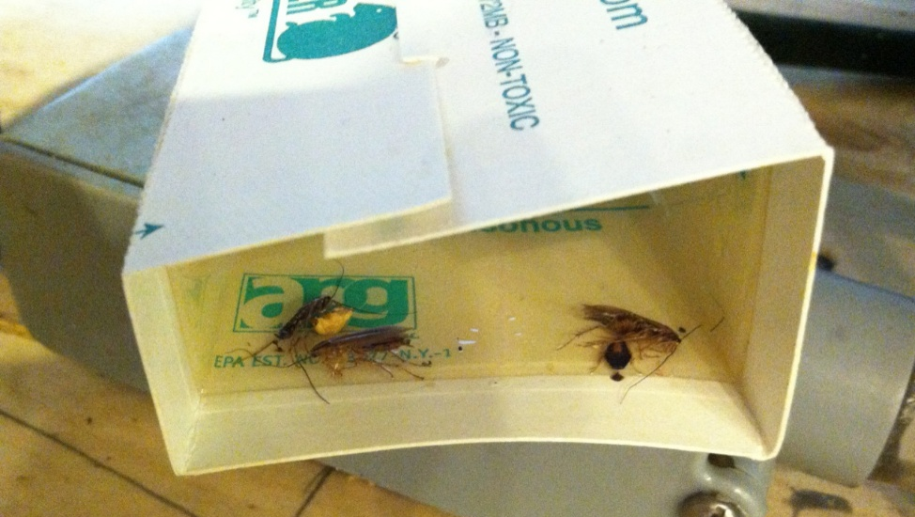
Disease-Carrying Vectors
PUBLIC HEALTH NUISANCE
Cochroaches
Notes:
Cockroaches are significant vectors for over 30 types of bacteria (including Salmonella and E. coli), viruses (such as Hepatitis A and Rotavirus), and parasites, often causing severe gastroenteritis, dysentery, and food poisoning. They spread these pathogens by contaminating food and surfaces with feces, vomit, and bacteria on their bodies. Additionally, their cast skins and feces are potent allergens, commonly triggering asthma and allergic reactions.
National Institutes of Health (NIH)
Key Diseases and Pathogens Carried
Bacterial Infections: Salmonella (Salmonellosis), Escherichia coli (E. coli), Staphylococcus aureus, Streptococcus, Shigella (Dysentery), Klebsiella pneumoniae, and Mycobacterium leprae (Leprosy).
Viral Diseases: Polio (Poliomyelitis) and Hepatitis A.
Parasitic Infections: Giardia, Cryptosporidium, and various parasitic worms.
Respiratory/Allergic Issues: Cockroach allergens (feces, saliva, shed skin) can cause, trigger, or aggravate asthma and allergic rhinitis (sneezing, runny nose, itchy eyes)

Slide 12
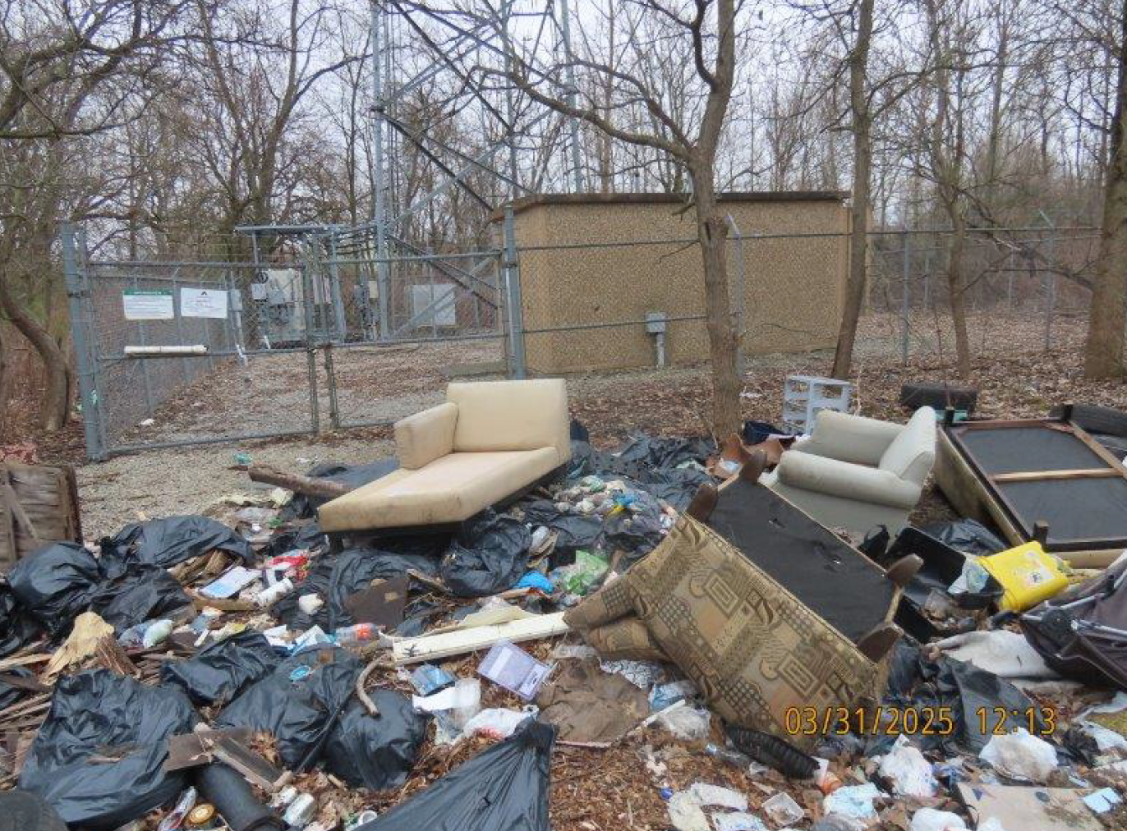
Open Dumping
Notes:
7 days for putrescible. Rats and Rodents, Flies, raccoons, etc
Sometimes, the owner owns their own stuff. The owner gives permission to another to dump on lot or by someone else on a vacant, unmanned lot. This was a vacant lot without the knowledge of the owner. Outside tower Waynesburg Dr, Canton Twp. Household trash, C&D, and tires. 1 month to get cleaned up. March-April 2025: After contacting the property owner.

Slide 13
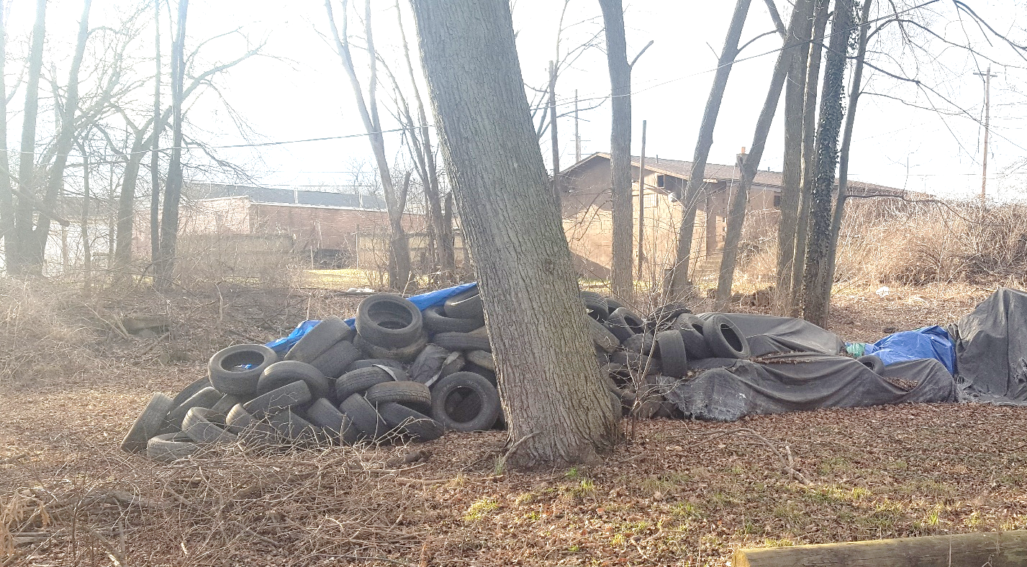
IMPROPER HANDLING OF SCRAP TIRES
PUBLIC HEALTH NUISANCE
Scrap tires that are not properly tarped or stored.
Notes:
Key Health and Environmental Harms:
Vector-Borne Disease Breeding Grounds: The curved, hollow shape of tires collects water, creating an ideal habitat for mosquitoes and rodents. A single tire can hatch thousands of mosquitoes in one season, which transmit diseases like West Nile Virus, dengue fever, and encephalitis.
Dangerous Tire Fires: Tires are difficult to extinguish, often burning for weeks or months, releasing toxic fumes (including carbon monoxide, cyanide, and sulfur dioxide). These fires create thick, hazardous smoke that causes severe respiratory distress.
Chemical Leaching and Contamination: As tires break down, they leach toxic heavy metals (lead, zinc, cadmium) and organic compounds into the soil and groundwater, which can contaminate drinking water.
Air Pollution from Decay: Even when not burning, stockpiled tires can release volatile organic compounds (VOCs) and methane into the air.
Long-Term Environmental Persistence: Tires can persist in the environment for centuries (taking up to 500–600 years to decompose).
Physical Hazards: Stockpiles are eyesores that reduce property values and, if located near water, can destroy habitats and trap wildlife.

Slide 14
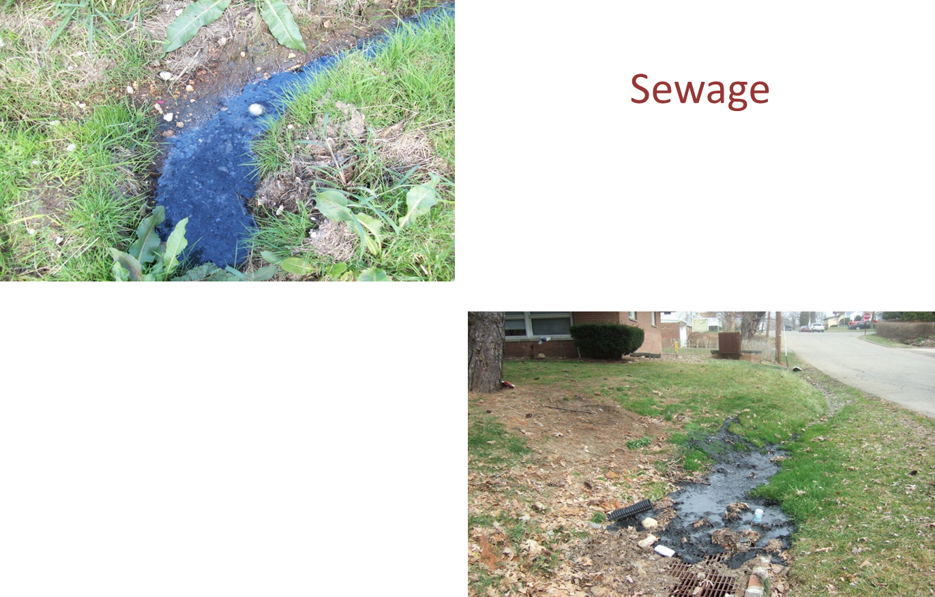
Sewage
PUBLIC HEALTH NUISANCE
Notes:
Sanitary Connections, Sewage Surfacing, Components of septic malfunctioning or failing. Deal with sewer gas as well
Key Health Impacts on People:
Waterborne Diseases: Ingestion of contaminated water leads to acute, sometimes fatal, gastrointestinal illnesses, including Ecoli, typhoid, cholera, dysentery, and viral gastroenteritis.
Infections (Direct Contact): Skin contact with raw sewage or contaminated water can cause infections like dermatitis, folliculitis, and cellulitis, especially if there are open wounds.
Respiratory Problems: Inhalation of airborne pathogens or toxic gases (methane, hydrogen sulfide) from sewage, especially in confined spaces or during backups, can lead to respiratory illnesses, headache, and nausea.
Contamination Risks: Untreated sewage can contaminate drinking water supplies, groundwater, and crops, allowing pathogens to enter the food chain.
World Health Organization (WHO) +7
Long-Term Health Effects: Exposure to heavy metals and chemicals often found in industrial sewage can cause neurological damage, organ failure, and cancer.

Slide 15

Indoor Smoking and Vaping at Workplaces
PUBLIC HEALTH NUISANCE
Notes:
Smoking ban is statewide-In 2006 Voter passed the Smoke Free Ohio Law. It is focused on indoor workplaces. Limit exposure to 2nd and 3rd hand smoke. I spent 18 years on this program. Important to note that the law also, includes vaping. The law was revised 4-5 years ago to include vaping products.

Slide 16

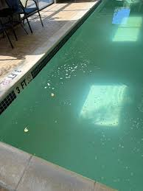
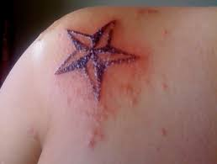
Licensed Facilities
PUBLIC HEALTH NUISANCE
Notes:
Pools, beaches, food, body art, and campgrounds. These programs give us the authority and responsibility to ensure that a public health nuisance does not exist. So for that reason, these complaints can be anonymous. I have worked in pools for 14 years. I can share that some of the saddest stories come from this program. Of course, drownings and near drownings are absolutely heartbreaking. Of course, in Ohio, many more happen at personal residences than at regulated, public pools. But we have had several chemical exposures. One was at a Stark County Hotel. The mom booked rooms to have a swim party for a bunch of 7-year-old girls. They were swimming in the hot tub and pool. Eventually, the girls started complaining that their skin was burning. Utilamtely when the mom spoke with me on Monday morning. Their suits were bleached, they had burns all over their skin that required medical treatment, and the girls were African American, and it burned chunks of hair off their heads. I went and asked for the facility to close. They fought me, but eventually did. They have a chemical controller for each pool and spa to add chlorine and muriatic acid to balance the pH. They maintain and the tech that comes in to manage the equipment, where out right this is not our fault, she is trying to file a frivolous lawsuit against us. I determined they had not been testing their chemistry as required. They were simply writing numbers down in a logbook. I reviewed the equipment and found the maintenance supervisor accidentally switched the sensors for chlorine and muriatic acid. The unit was pouring acid into the pool thinking it was disinfectant. These poor girls were swimming extremely high concentrations of acid.

Slide 17
Not all “eye sores” are public health nuisances.
Notes:
These are things we cannot win the case.

Slide 18
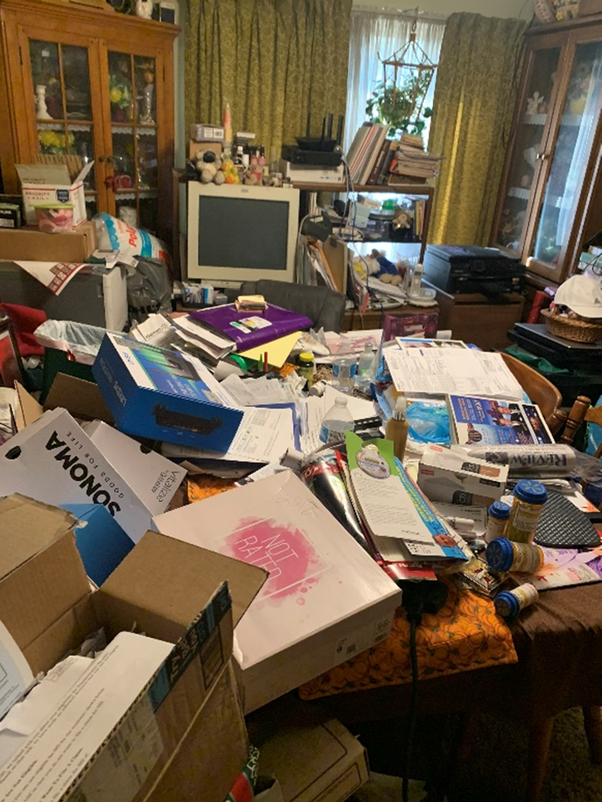
HOARDING AND INTERIOR CONDITIONS
NON-PUBLIC HEALTH NUISANCES
Notes:
Clutter, paper are okay. People have rights to live as they see fit. Until it affects the neighbors. Rats, coachroaches, etc going to neighboring unit, then we are involved.

Slide 19
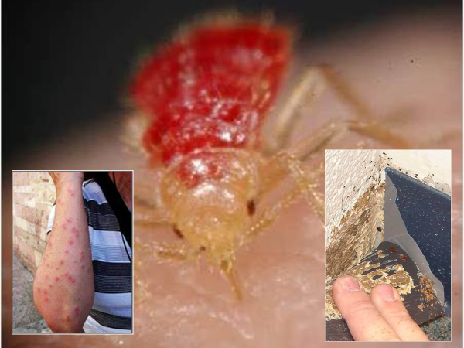
BEDBUGS
NON-PUBLIC HEALTH NUISANCES
Bedbugs do not spread diseases and are not a public health nuisance.
Notes:
Our department does a lot with education. That fails on me back in 2008.

Slide 20
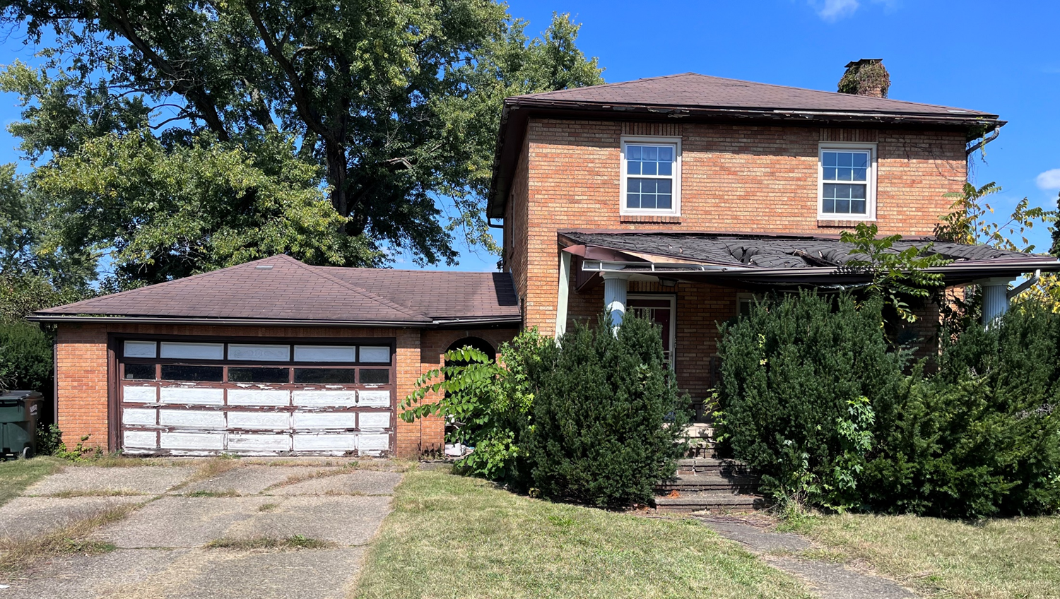
BUILDING AESTHETICS
NON-PUBLIC HEALTH NUISANCES
Overgrown vegetation, minor structural damage, etc.
Notes:
If no signs of vectors and it is secure then we wont follow-up.

Slide 21
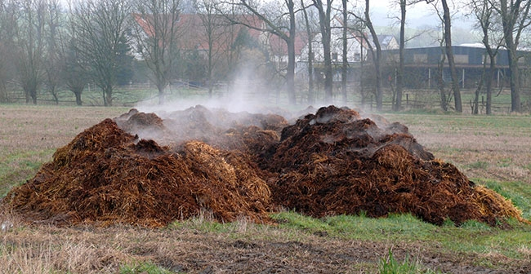
AGRICULTURAL WASTE (MANURE)
NON-PUBLIC HEALTH NUISANCES
Under the Department of Agriculture
Notes:
This fails under the Ohio Dept of Agriculture. We hear this as an excuse for why failing septics are okay, because neighbor fred spread’s manure on his farm field.

Slide 22
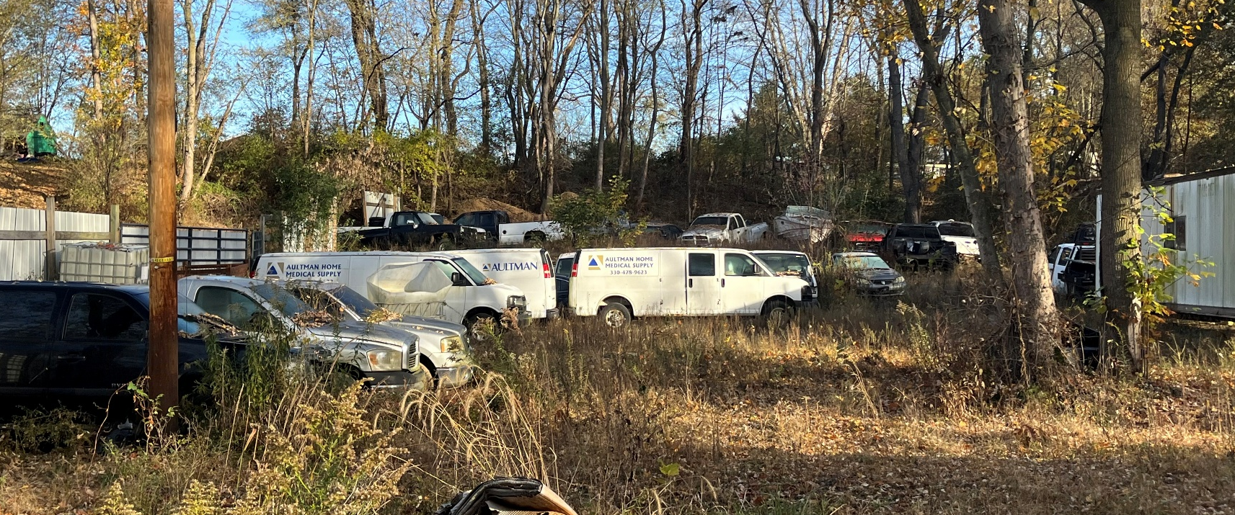
ABANDONED VEHICLES
NON-PUBLIC HEALTH NUISANCES
Junkyards and Salvage yards have own regulations.
Notes:
If secure and not a source of vectors we will dismiss the complaint. Now if it is filled with solid waste and window is open and hoarding vectors then yes.

Slide 23
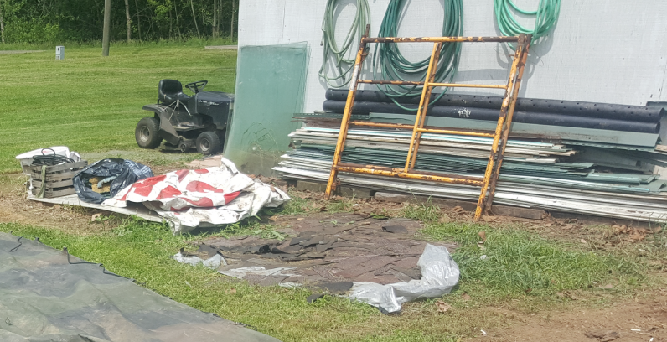
Recyclables or Building Materials
NON-PUBLIC HEALTH NUISANCES

Slide 24
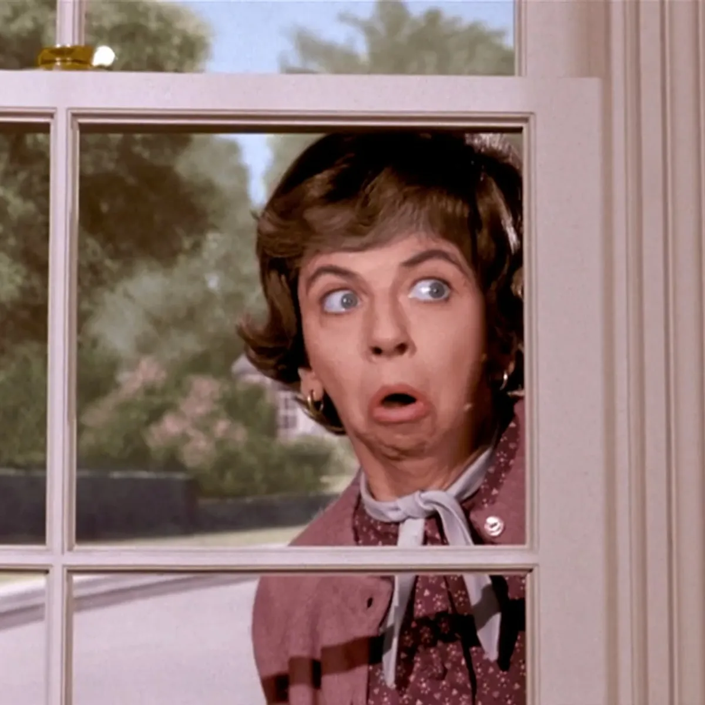
Nosy Neighbors
NON-PUBLIC HEALTH NUISANCES
Notes:
Burned down hose this summer. In the works with the insurance company. The property owner hired a third-party advocate to negotiate with the insurance company. This meant the lengthy process was going to take longer than normal, and all goods needed to be cataloged by the company. The neighbor, who was best friends for over a decade, didn’t like the look of the home. She would call and yell and scream at me because “how do you expect to enjoy my summer in my pool when I have to look at that.

Slide 25
Dangerous Structures

Slide 26

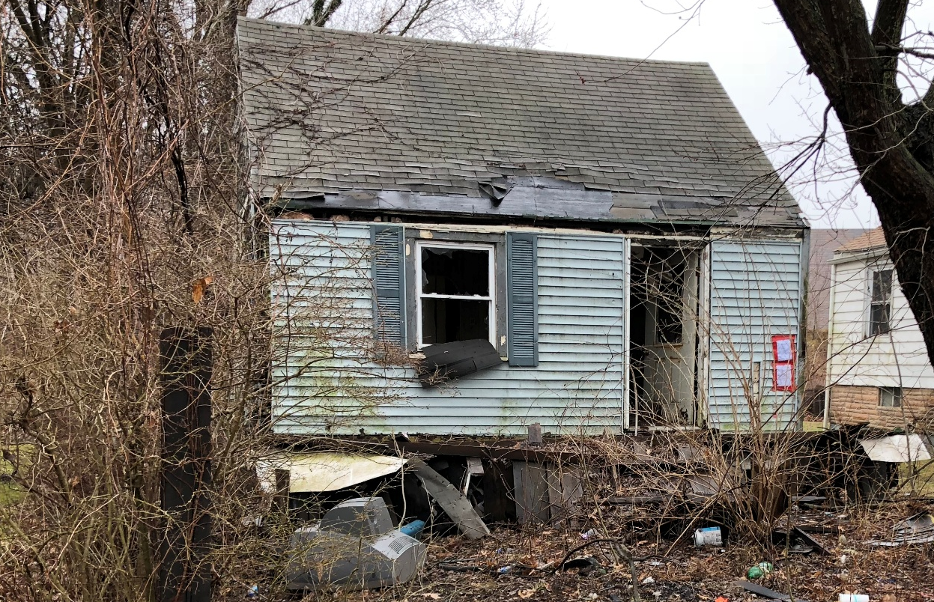
A building, house, or other structure….
Out of repair and dilapidated by way of want of repair, defective drainage, plumbing, lighting, ventilation, or construction, as to be declared insecure, unsafe, or structurally defective.
Notes:
Not all properties would fall under our definition of public health nuisances but may be dangerous structures.

Slide 27
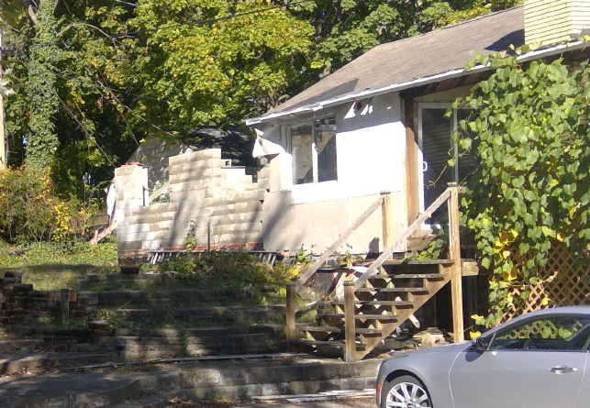
ORC 505.86/715.29
Notes:
They is an option for the township city or village
This is a property in Jackson Twp. As you can see the home was under construction in the back. The home is cleaned out and a tough case for us to say it is disease-causing (public health nuisance). Of course who wants to live next to a structure that looks like that. Impacts on nearby home values and begins neighborhood blight.
If a Township within the Stark County Health District has a dangerous structure, SCHD recommends they contact their legal counsel and strongly encourages they follow this type of enforcement process. NUISANCE ENFORCEMENT of a Dangerous Structure – Ohio Revised Code Section 505.86(B) allows a board of township trustees to provide for the removal, repair or securing of buildings or other structures in the township that have been declared insecure, unsafe or structurally defective by any authority responsible under O.R.C. Chapter 3781. Upon receipt of a nuisance complaint from a resident of a township or by direction of any official or employee of township, which may require the removal, repair or securance of buildings or other structures on the property, the political subdivision will investigate the property, take photographs and make notes which will be used to assist the Board of Trustees in the determination of the constitution of a nuisance under the guidelines of the law. Once a nuisance is determined, the political subdivision must have an appropriate declaration issued by either the Local Fire Chief, the County Building Department or the County Health District acting as an authority responsible under O.R.C. Chapter 3781.
Recommend seeking legal cousel

Slide 28
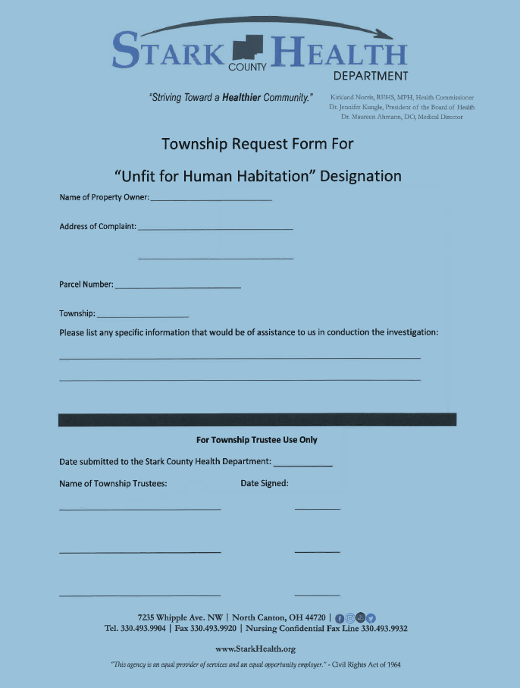
Dangerous Structure
Notes:
If you would like our support in utilizing 505.86. I will ned you to complete our form.
, a Registered Environmental Health Specialist will visit the property, document
through photos and written documentation what was seen and report back to the department. If the Stark County
Health Department deems the structure is in fact “Unfit for Human Habitation”, a notice will be posted on the
property door and mailed to the property owner, and notice will be given to the political subdivision

Slide 29
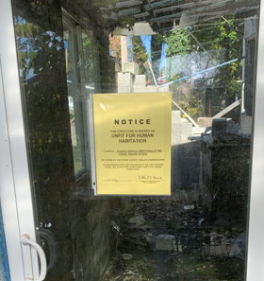
“Unfit for Human Habitation”
Notes:
Our office will post the door and send your office confirmation. Then you would work with legal to continue the process to remove the property and assess the property.

Slide 30
Complaint Process

Slide 31
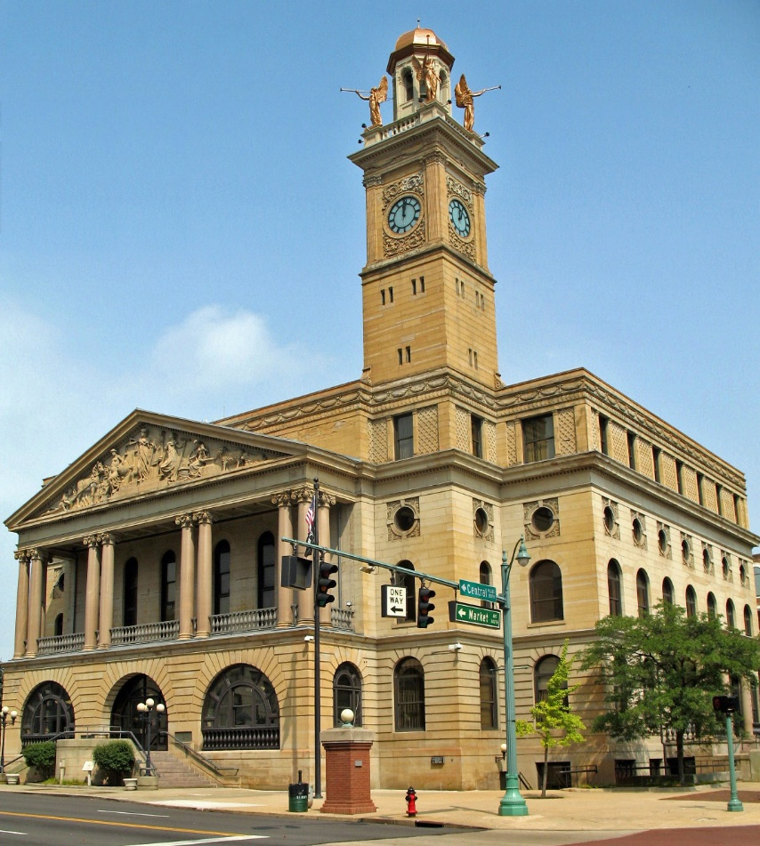
Complaint Process
Complaint is received & inspection conducted
Specialist Order issued if the complaint is justified
Non-compliance with the Specialist Order results in a Public Health Order
Non-compliance with the Public Health Order results in the County Prosecutor’s Office filing a case with the Stark County Court System
Notes:
Most orders have a 30 day time frame. Garbage, sewer backups have 7 day. Sanitary Sewer connections 120 days

Slide 32
DELAYS IN THE ABATEMENT PROCESS
Complaint must be a Public Health Nuisance
  Not all nuisances or “eye-sores” are public health nuisances;
Due Process;
Delays in achieving compliance occur when:
  Property owner is deceased,
  Owner has abandoned the property,
  No service address,
  Owner is in jail,
  Owner has been ill or in the hospital,
  Signs posted - No Trespassing – Private Property – Trespassers will be shot.
  NOTES: Progress is being made, but at a slower pace.
Notes:
Our own compliance with policies, code, rights of the homeowner,
We are looking at other mechanisms for compliance. As just like other agencies sometimes we struggle to move cases forward.

Slide 33
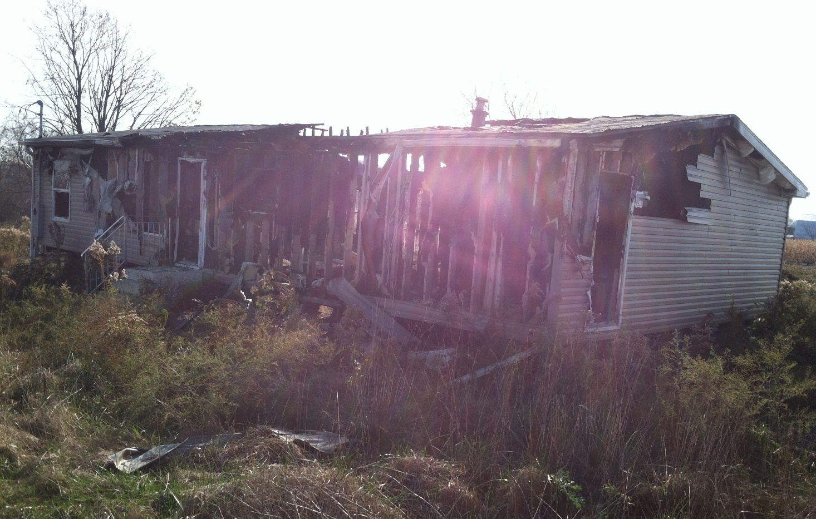
Courtney Myers
myersc@starkhealth.org
330-451-1472

